Slide 1
Corona Virus Recognition Using Chest X Ray Images
Presented By:
Ankit Ku. Pradhan 190301120005
A Deepak - 190301120069

Slide 2
Table of Content
1 | Introduction
2 | Objective
3 | Data Set
5 | Theoretical Background
6 | Flow Diagram
7 | Result
8 | Conclusion
9 | References

Slide 3
Introduction
The novel coronavirus disease 2019 (COVID-19) constitutes a public health emergency globally. The number of infected people and deaths are proliferating every day, which is putting tremendous pressure on our social and healthcare system. Rapid detection of COVID-19 cases is a significant step to fight against this virus as well as release pressure off the healthcare system.

Slide 4
Objective
One of the critical factors behind the rapid spread of COVID-19 pandemic is a lengthy clinical testing time. The imaging tool, such as Chest X-ray (CXR), can speed up the identification process. Therefore, our objective is to develop an automated CAD system for the detection of COVID-19 samples from healthy and covid cases using CXR images.

Slide 5
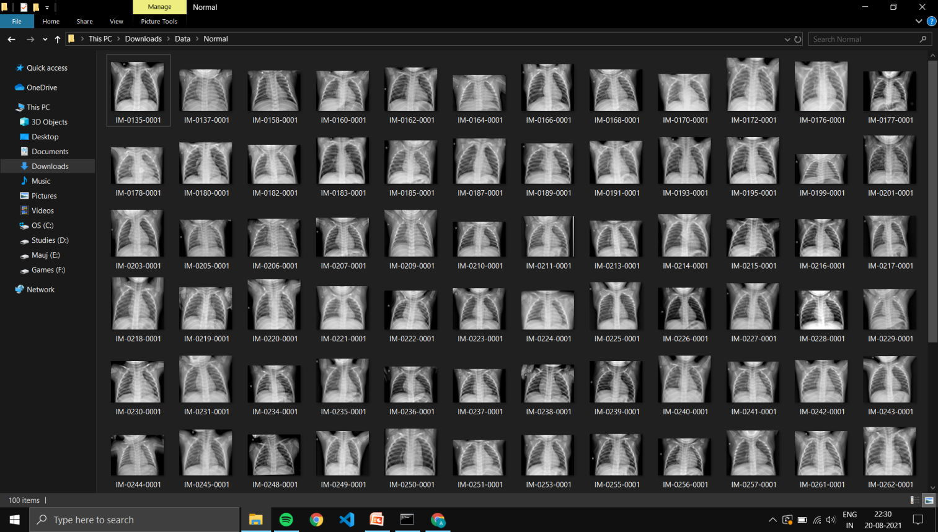
Data Set
https://www.kaggle.com/paultimothymooney/chest-xray-pneumonia

Slide 6
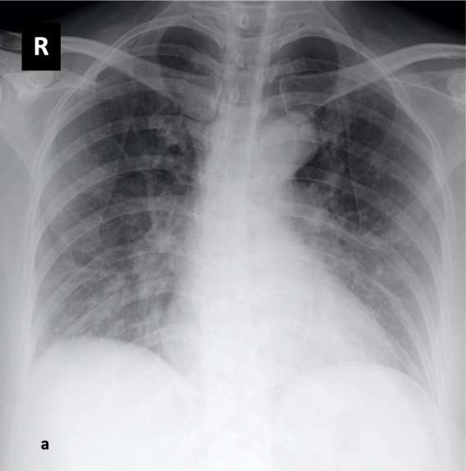
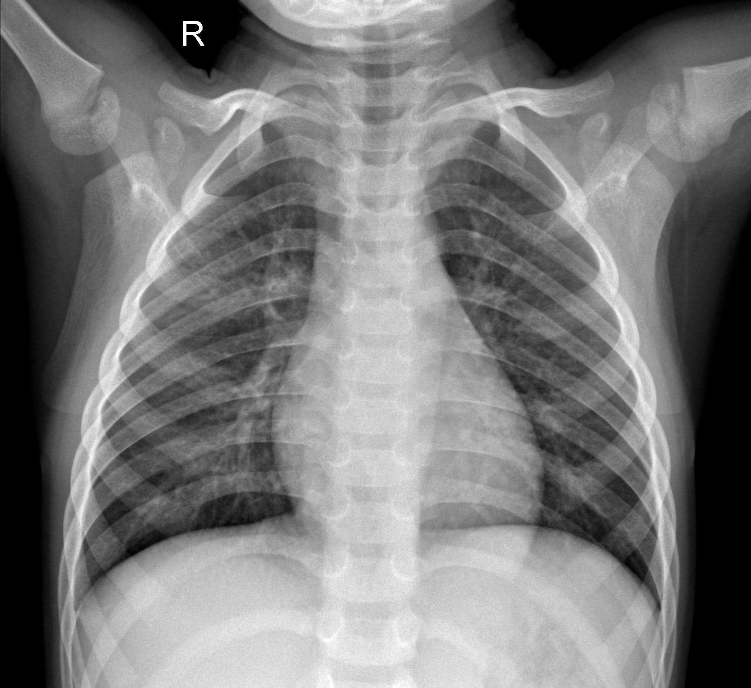
Covid
Normal

Slide 7
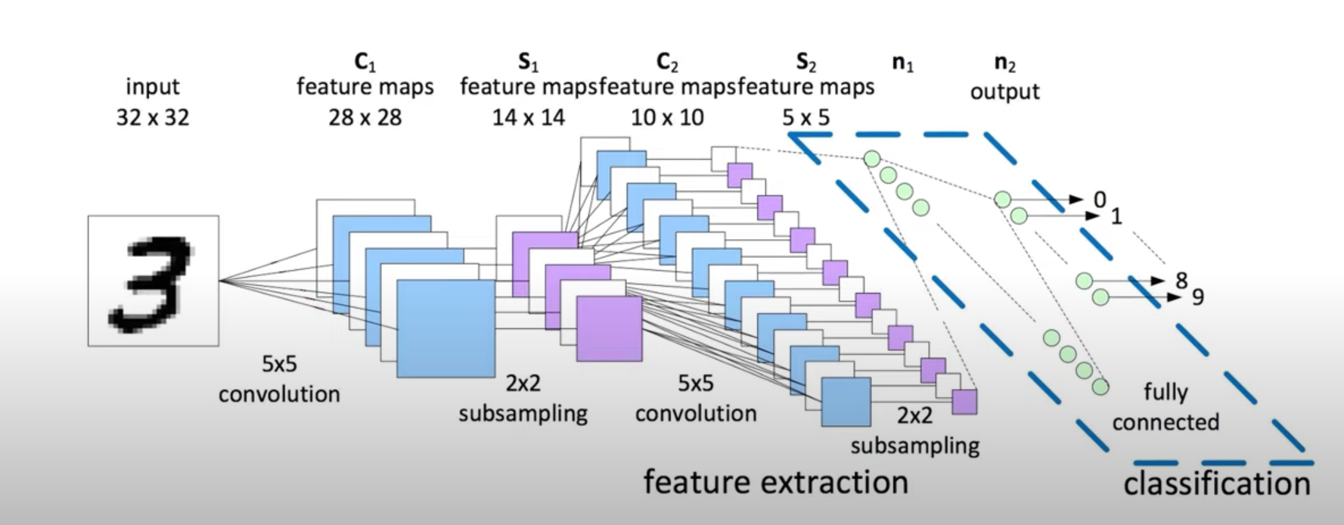
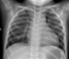
Theoretical Background
CNN
Inspired by visual system of human brain.
To make the computers capable of viewing the world as humans view it.
Can be used in the fields of image recognition and analysis, image classification, and natural language processing .

Slide 8
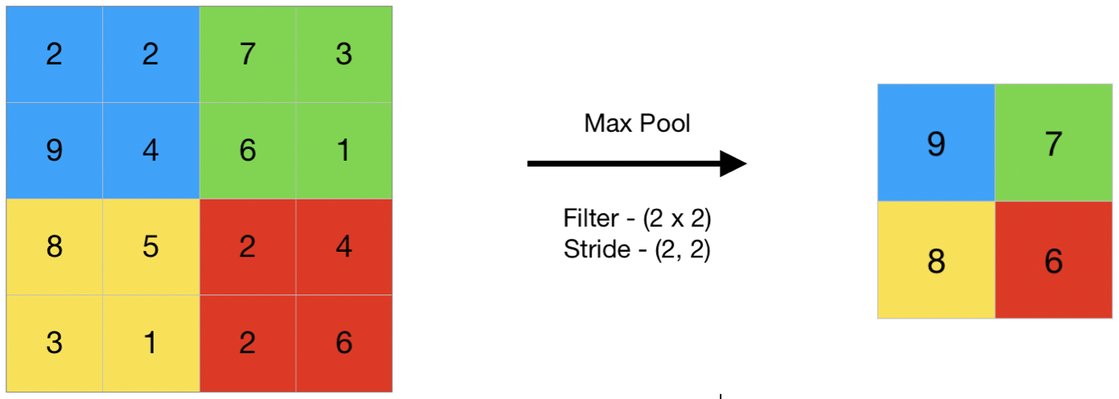
Maximum pooling or max pooling is a pooling operation that calculates the maximum or largest value in each patch of each feature map.

Slide 9
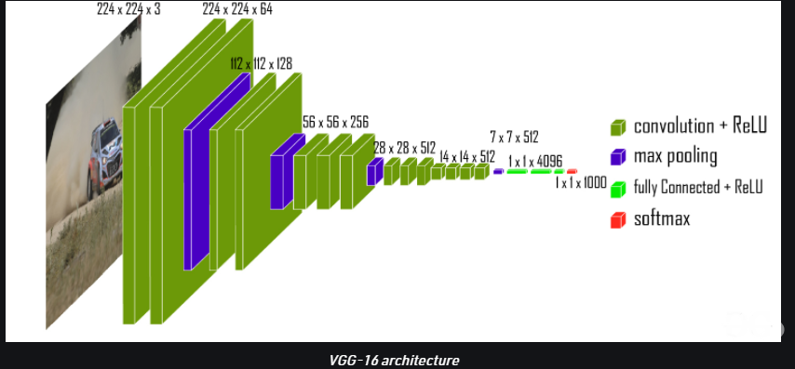
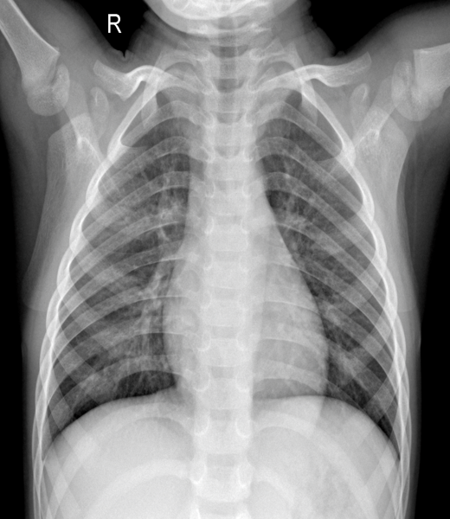
VGG-16 Architecture

Slide 10
Flow Diagram
Flow Diagram
Start
Import Dataset
Image Preprocessing
Splitting data
Data Augmentation
Prediction
End
Model Building

Slide 11

Import Dataset
Collecting of Data from Kaggle.
Total of 200 chest X-ray images:-
100 of Covid
100 of Normal

Slide 12
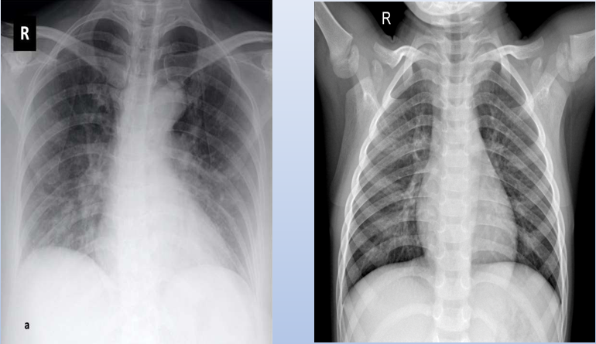
Image Processing
Resizing of the images were done. The size was 224 x 224. Then the images were converted to RGB channel.
Labelling of Data

Slide 13
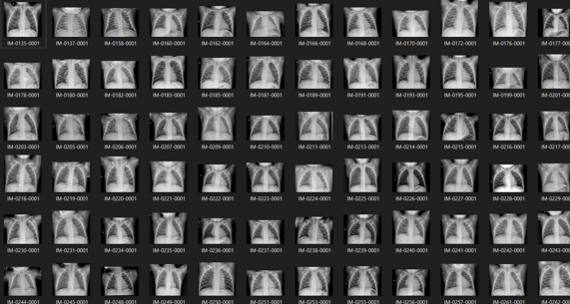
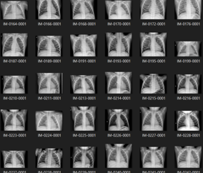
Splitting of Data
Dividing data into training and testing:
80% data for training
20% data for testing

Slide 14
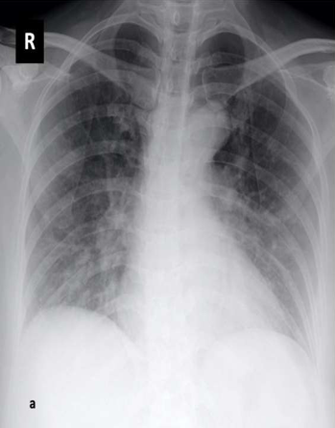
Data Augmentation
Data augmentation
As they are very few images in our dataset. To train and validate our model so that it gives good performance data augmentation is applied.

Slide 15
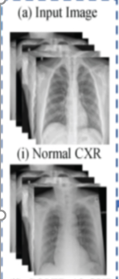
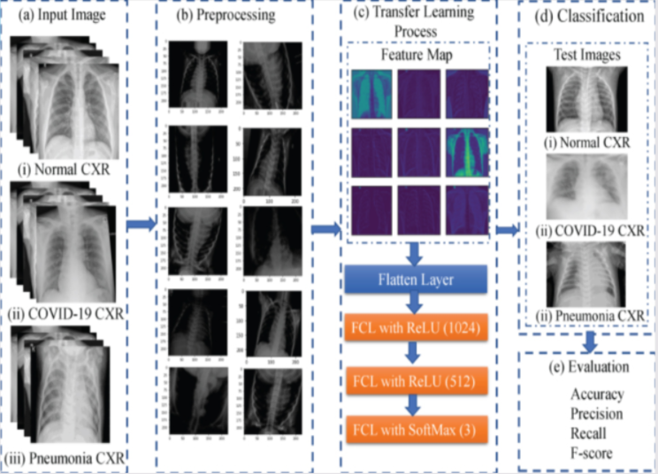
Model Building

Slide 16
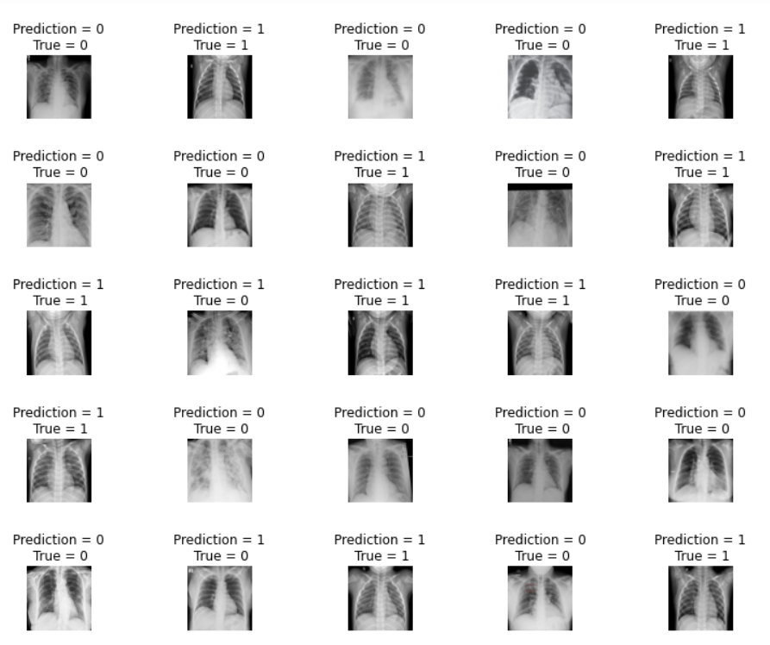
Result

Slide 17
Classification Report
 | precision | recall | f1-score | support
Covid | 1.00 | 0.95 | 0.97 | 20
Normal | 0.95 | 1.00 | 0.98 | 20
accuracy |  |  | 0.97 | 40
macro avg | 0.98 | 0.97 | 0.97 | 40
weighted avg | 0.98 | 0.97 | 0.97 | 40

Slide 18
Confusion Matrix
0 | True Neg 19 47.50% | False Pos 1 2.50%
1 | False Neg 0 0.00% | True Pos 20 50.00%
 | 0 | 1

Slide 19
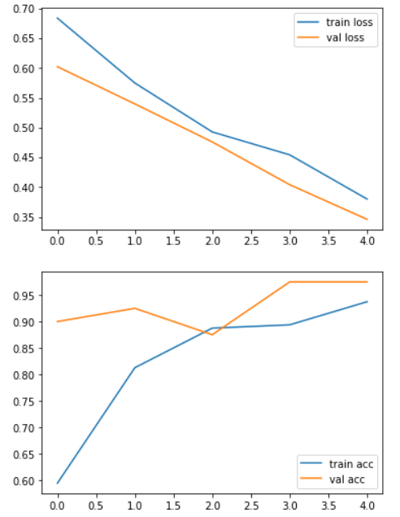
Graphs

Slide 20
Conclusion
Detection of covid – 19 using CXR images is of vital importance for both doctor and patience to decrease the diagnostic time and reduce financial cost. CNN technique is capable of recognizing images for the tasks taught. In this project several experiments were performed for the high accuracy detection of the covid -19 in CXR images using CNN (VGG16 model)

Slide 21
Reference
1. Wu F., Zhao S., Yu B. A new coronavirus associated with human respiratory disease in China. Nature. 2020;579(7798):265–269. [PMC free article] [PubMed] [Google Scholar]
2. Huang C., Wang Y. Clinical features of patients infected with 2019 novel coronavirus in Wuhan, China. Lancet. 2020;395(10223):497–506. [PMC free article] [PubMed] [Google Scholar]
3. World Health Organization . World Health Organization (WHO); 2020. Pneumonia of Unknown Cause–China. Emergencies Preparedness, Response, Disease Outbreak News. [Google Scholar]
4. Wu Z., McGoogan J.M. Characteristics of and important lessons from the coronavirus disease 2019 (COVID-19) outbreak in China: summary of a report of 72 314 cases from the Chinese Center for Disease Control and Prevention. Jama. 2020;323(13):1239–1242. [PubMed] [Google Scholar]
5. Holshue M.L., DeBolt C. First case of 2019 novel coronavirus in the United States. N. Engl. J. Med. 2020;328:929–936. [PMC free article] [PubMed] [Google Scholar]
6. Kong W., Agarwal P.P. Chest imaging appearance of COVID-19 infection. Radiology: Cardiothoracic Imaging. 2020;2(1) [Google Scholar]
7. Singhal T. A review of coronavirus disease-2019 (COVID-19) Indian J. Pediatr. 2020;87:281–286. [PMC free article] [PubMed] [Google Scholar]
8. Zu Z.Y., Jiang M.D., Xu P.P., Chen W., Ni Q.Q., Lu G.M., Zhang L.J. Coronavirus disease 2019 (COVID-19): a perspective from China. Radiology. 2020 doi: 10.1148/radiol.2020200490. In press. [PMC free article] [PubMed] [CrossRef] [Google Scholar]
9. Kanne J.P., Little B.P., Chung J.H., Elicker B.M., Ketai L.H. Essentials for radiologists on COVID-19: an update—radiology scientific expert panel. Radiology. 2020 doi: 10.1148/radiol.2020200527. In press. [PMC free article] [PubMed] [CrossRef] [Google Scholar]
10. Xie X., Zhong Z., Zhao W., Zheng C., Wang F., Liu J. Chest CT for typical 2019-nCoV pneumonia: relationship to negative RT-PCR testing. Radiology. 2020 doi: 10.1148/radiol.2020200343. In press. [PMC free article] [PubMed] [CrossRef] [Google Scholar]

Slide 22
THANK YOU

